Slide 1
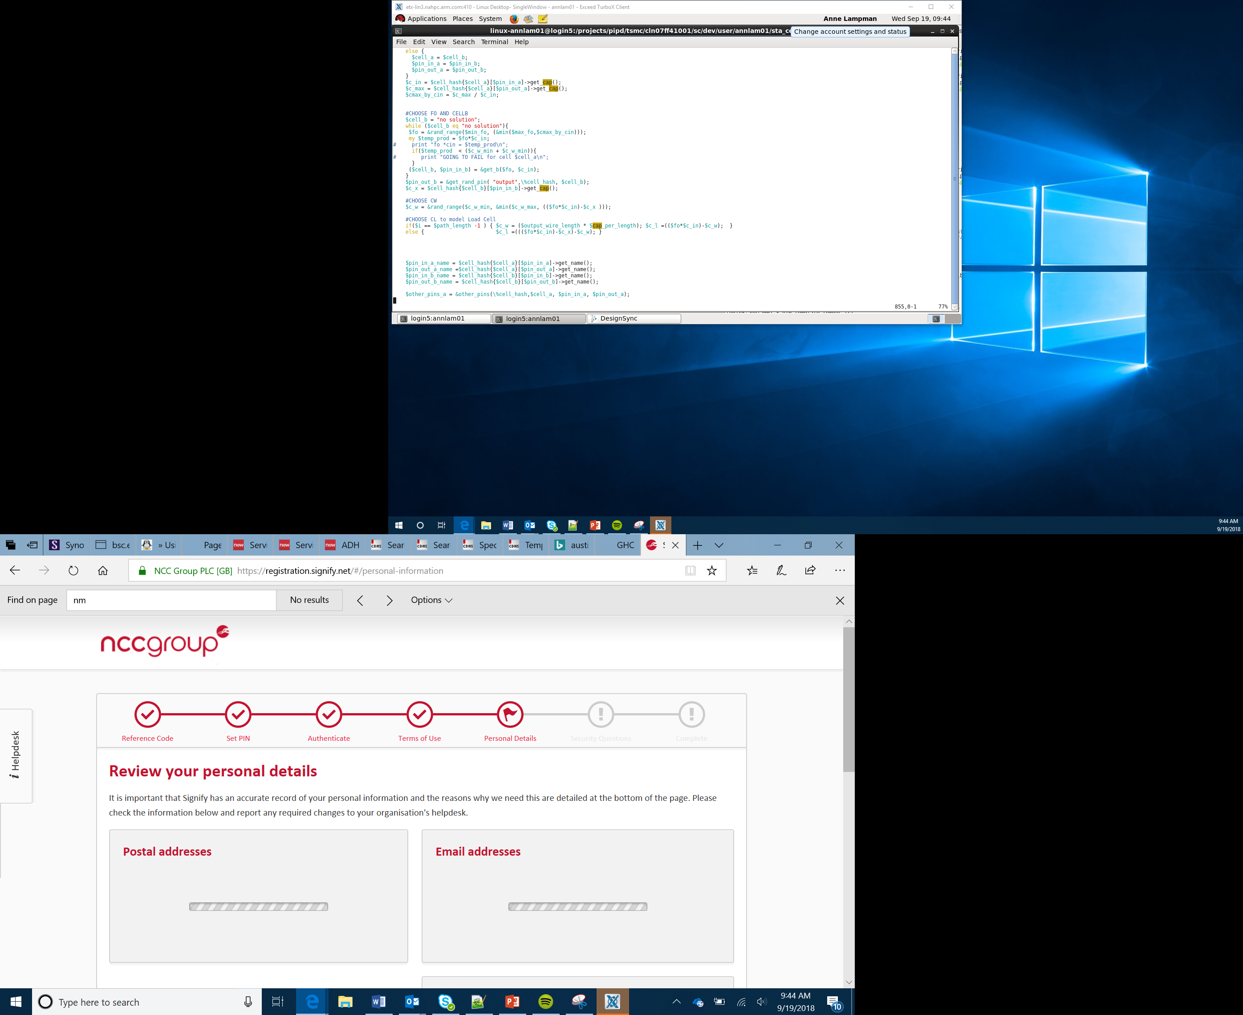

Drawing Pictures
Lesson 6

Slide 2
Objectives
Apply your understanding of motor outputs
Develop your understanding of iteration (looping) using conditional loops and count controlled loops
Be able to plan and drawn shapes using iteration
Notes:
This lesson could run straight on from Lesson 6 and be a good way for Learners to test their Bit:Bots

Slide 3
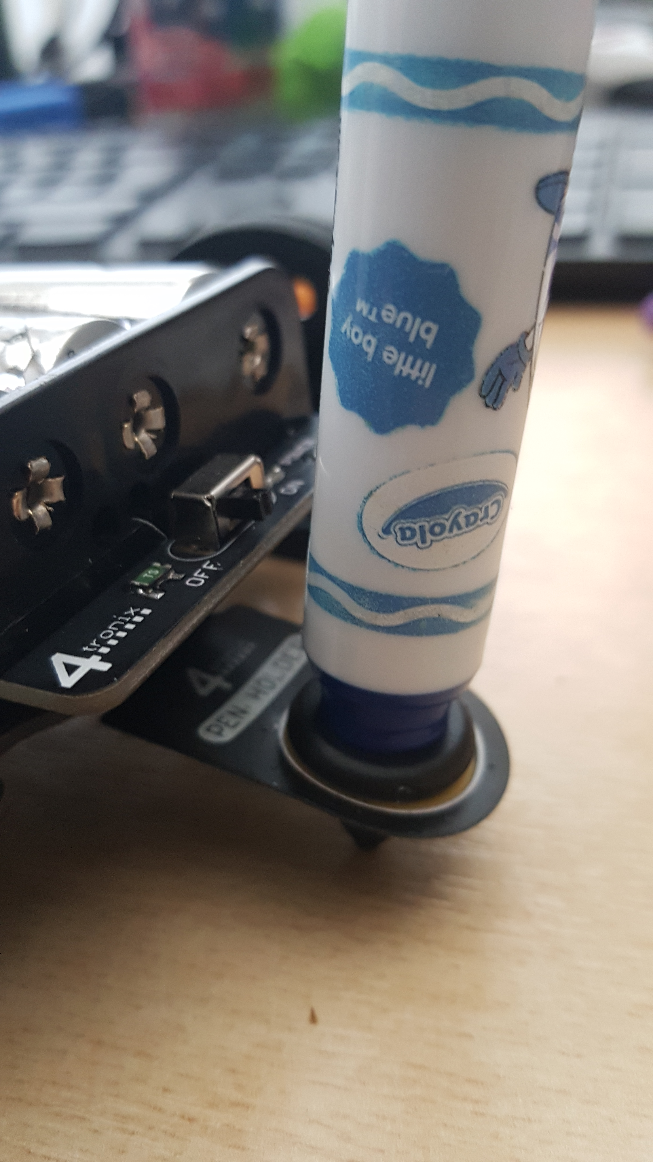
The Pen Holder
Mount a felt tip pen or crayon on the pen holder
Test it draws a line by driving the motor forward or reverse to create a line
Notes:
Show Learners how to correctly mount the pen holder and adjust it for best use

Slide 4
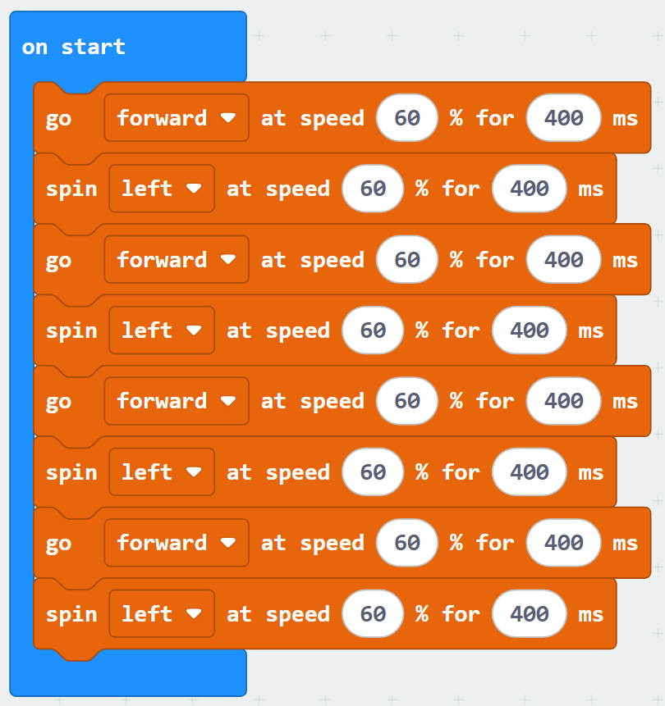
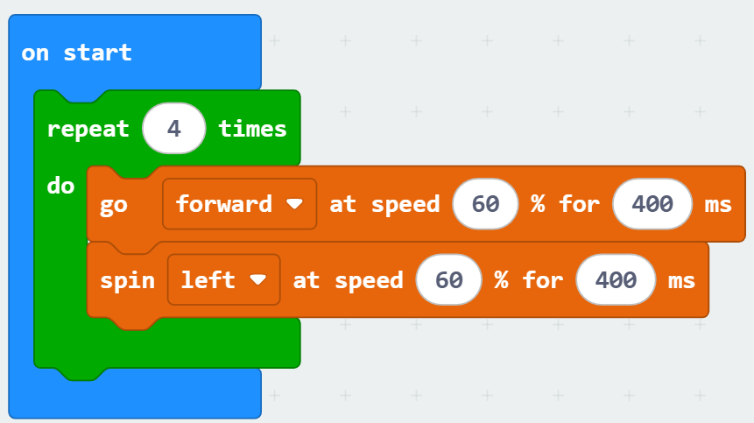
Sequence & Iteration
Sequence is one instruction followed by another
Iteration is a coding feature that allows us to repeat commands instead of typing them in again
Iteration is more efficient as it uses less memory and you are less likely to make mistakes
Notes:
Discuses sequence and iteration as two key programming constructs
Remind Learners of the limited memory space within the micro:bit (16k)
Get them to consider why iteration my help save memory space

Slide 5
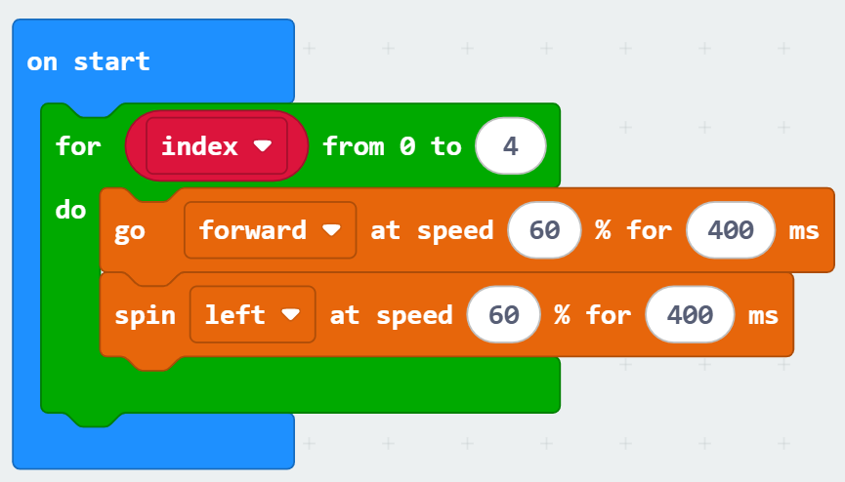
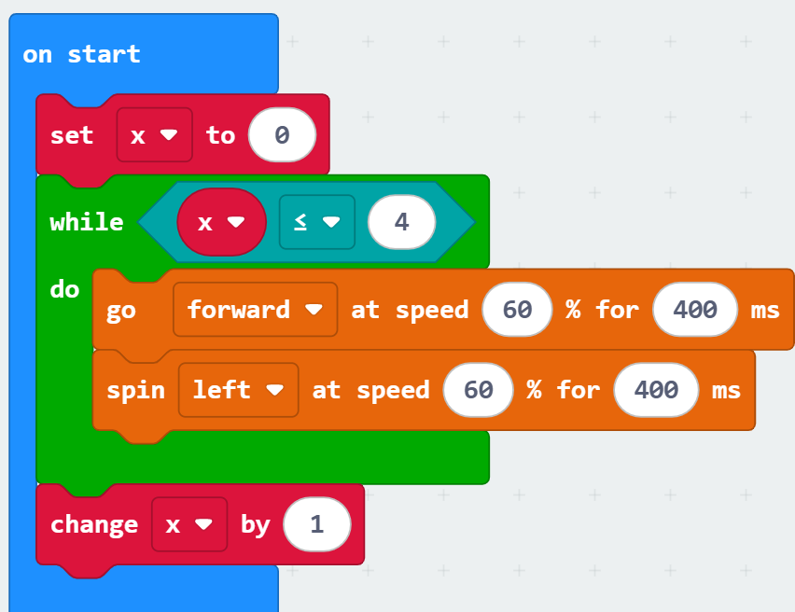
Count Controlled and Conditional
Count controlled loops (for loops) are used when you know how many times you want to do something
Conditional loops (while loops) happen while a condition is true or false
Notes:
Ensure Learners are aware of the concept of count controlled loops and conditional loops and when you might use these.

Slide 6
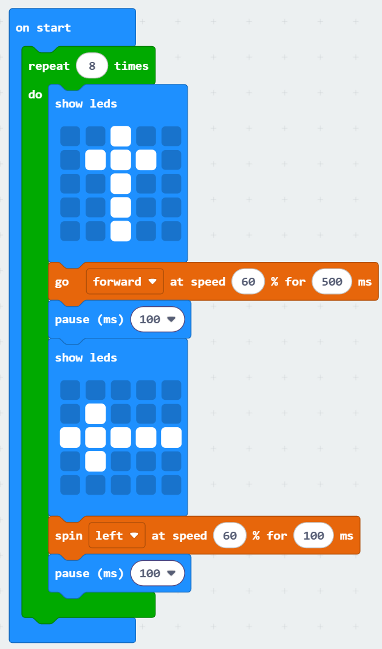
Drawing Challenge
Use your Bit:Bot to complete the following challenges:
Draw a Square
Draw a Triangle
Draw any other regular polygon
Draw a circle
Remember:
Predict the directions and angles required
Investigate how this compares to the motors and surfaces used
Modify you code and Make it happen
Notes:
Get Learners to use their pen holder to draw set shapes
Remind them of The PIMM methodology and to look back at the lesson on motors
The key point here is for Learners to try to figure out how to turn a specific angle using power and time.
There is no correct answer here as it is dependent on floor material and battery charge though 600 for 400ms in the previous demo did a 180 turn on a tiled floor and a speed of 600 and turn of 200ms is about 90deg and 600 @100ms is about 45 degrees so this works out at roughly 2.2ms per degree but this is very battery and floor material dependent
The slower you turn the more precise you can be
Learners will have to apply trial and error

Slide 7

Success Criteria
Apply your understanding of motor outputs
Develop your understanding of iteration (looping) using conditional and count controlled loops
Be able to plan and drawn shapes using iteration
Notes:
Introduce the Task and Activity sheet
Support an encourage Learners to attempt Stretch Task

